Slide 1

Managing Business Risks in a Pandemic
Dr Nathan Pinskier, Dr Maria Boulton,
Aaron Crosthwaite

Slide 2
Program
Dr Nathan Pinskier
  Business Issues
Dr Maria Boulton
  Issues and Practical Solutions
Aaron Crosthwaite
  Cash flow and Finance
Dr Mukesh Haikerwal
  Telehealth progress update
Q&A

Slide 3

Cashflow and Finance
Presenter:
Aaron Crosthwaite
Director
Curve Accountants

Slide 4
Cashflow and Finance
Government’s Economic Response to the Coronavirus (“Government Stimulus”
Just looking at the aspects that are relevant to small businesses cash flow:
Boosting cash flow for employers
Increasing instant asset write-off
Backing business investment

Slide 5
Cashflow and Finance
Government’s Economic Response to the Coronavirus (“Government Stimulus”
“Boosting cash flow for employers” initiative
Small-to-medium business (turnover up to $50 million) that employ persons may be eligible to receive a total payment of up to $100,000 (with a minimum of $20,000).
Payment will be made in 2 stages:
Starting from 28 April, eligible employers will receive a tax-free payment equal to 100% of their PAYG Withholding up to a maximum of $50,000 (or $10,000, whichever is higher).
As long as still an active employer, an additional tax-free amount will be received starting from 28 July which will be 100% of whatever you received in the first stage. Minimum of $10,000 and maximum of $50,000 for Stage 2.

Slide 6
Cashflow and Finance
Government’s Economic Response to the Coronavirus (“Government Stimulus”
“Boosting cash flow for employers” initiative
The timing of the payment will depend on whether you lodge activity statements monthly or quarterly – but regardless you will get at least $10,000 from 28 April 2020, as long as you have lodged March BAS/IAS.
Any balance you may be entitled to will be paid via IAS/BAS lodged for months covering April to June 2020.
The second stage will be 50% of Stage 1 payment on 28 July and 50% on 28 October if lodging quarterly; or spread over June to September activity statements if lodging monthly (25% for each of the 4 monthly IAS).

Slide 7
Cashflow and Finance
Government’s Economic Response to the Coronavirus (“Government Stimulus”
“Boosting cash flow for employers” initiative
Be careful: Although not in the government announcement, the legislation passed with a specific integrity measure – if an employer enters into a scheme for the dominant purpose of obtaining or increasing any of the above payments – the employer will not be eligible for any such payments for the relevant period.

Slide 8
Cashflow and Finance
Government’s Economic Response to the Coronavirus (“Government Stimulus”
“Increasing instant asset write-off” initiative
From 12 March, instant asset write-off threshold will be increased from $30,000 (when turnover of less than $50m) to $150,000 (for businesses with turnover of less than $500m).
Applies to both new and second-hand assets, up to 30 June 2020.
Applies to GST-exclusive cost.
Cars still subject to $57,581 car limit for depreciation.

Slide 9
Cashflow and Finance
Government’s Economic Response to the Coronavirus (“Government Stimulus”
“Backing business investment” initiative
From 12 March, for businesses with turnover below $500 million, you can deduct 50% of the cost of the asset in the year of purchase.
The balance is subject to normal rules.
For those small businesses using a ‘small business pool’ you can deduct an amount equal to 57.5% (rather than 15%) of the asset cost in the year it is allocated to the pool
This will be useful for purchases above the $150,000 instant write-off limit – but also unlike that it goes beyond 30 June 2020 (goes to 30 June 2021).

Slide 10
Cashflow and Finance
Cashflow issues
First steps…
In most cases you will be acutely aware of cashflow issues, but if you are unsure/worried:
  Check billings for previous day and compare with the day before
  Check billings for previous week and compare with the week before
  If usually have bookings 7 days in advance, has it dropped to 5 days? 4 days?
  Small variations (e.g. 5% or under) could be normal fluctuations, but any larger differences will likely indicate
It is possible that currently we are looking at peak panic / peak affect on GP billings for the current week or two – don’t assume it will always be like this – think about things 8 weeks from now, before laying off staff and making large changes.
Keep a cashflow buffer even if not affected yet – hold onto as much cash as you can for next month or two. Possibly put government stimulus into business savings account.
Expenses need to decrease if income is deceasing –payroll, loan repayments and rent will be your two biggest cashflow outgoings.

Slide 11
Cashflow and Finance
Cashflow issues
Talk with your staff
If cashflow decreasing, likely that means there is less need for administrative and nursing staff. Can any casual employees be kept off the roster for 2 weeks. Let them know it should only be 2 weeks, but you will let them know asap if any changes.
For permanent staff:
  Under the Fair Work Act, an employee can only be stood down without pay if they cannot be usefully employed because of a stoppage of work for any cause for which the employer cannot reasonably be held responsible.
  Employer must demonstrate there is a stoppage of work, and that they cannot otherwise be usefully employed in other work (than what they usually do).
  They are technically still employed.

Slide 12
Cashflow and Finance
Cashflow issues
Talk with your bank
If you notice cashflow decreasing quickly, talk to your bank. Every bank has contact details especially for Covid-19 issues.
If you are a small business, all banks are currently offering to defer business loan repayments for 6 months, if you ask them.
Most banks offering for home loans as well.

Slide 13
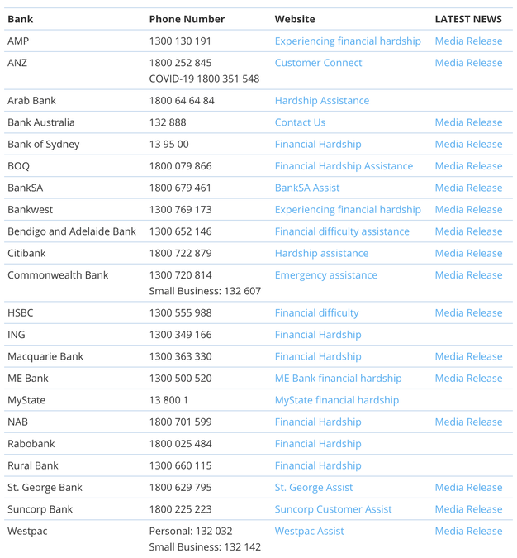
Cashflow and Finance
Cashflow issues
Talk with your bank
Link to contact details of all banks: https://www.ausbanking.org.au/campaigns/financial-hardship/

Slide 14
Cashflow and Finance
Cashflow issues
Talk with your bank
Part of government stimulus was the offer of fixed low-interest (0.25%) funding facility to banks who expand business lending to small businesses plus a 50% government guarantee on new small business loans up to $250,000 per borrower.
Some banks have announced they can drop small business loan rate to around 4.5% and loans will be interest free for the first 6 months.
Here is a good summary of what’s available so far:
https://mozo.com.au/business-banking/articles/guide-to-australian-government-and-banks-coronavirus-support-for-small-businesses

Slide 15
Cashflow and Finance
Cashflow issues
Talk with your landlord
If you are your own landlord:
  Property in family trust – consider stopping rent for a month or two as necessary
  Property in SMSF – due to SMSF regulations, have to be careful. Recommendation is to have a rent reduction due to market circumstances until further notice, as long as allowable under your lease (otherwise organise for lease to be varied). Rent deferrals/holidays may be cause issues.
If someone else is your landlord:
  I have already seen landlords voluntarily offering 50% reductions in rent for months of April and May. Ask your landlord if they can offer any temporary reductions in rent. Commercial properties usually have a long period between tenants, so landlords will want to keep existing tenants around where possible.

Slide 16
Cashflow and Finance
Cashflow issues
Talk with your accountant
Vary March 2020 and/or June 2020 PAYG instalments if less income for the quarter
Payment plans with ATO for upcoming payments – should be able to organise relatively easily for payments under $100,000 and potentially have interest waived for 12 months as well (if mention to ATO due to coronavirus)
Can request deferrals for tax payments due after 23 January 2020
Keep up to date with bookkeeping so you know what your position is – you might need it up to date for finance also.

