Slide 1

COVID-19
Update and Issues
Dr Nathan Pinskier, Dr Bernard Shiu,
Dr Mukesh Haikerwal

Slide 2
Program
Dr Nathan Pinskier
  Friday 6 March Commonwealth Meeting Report
Dr Bernard Shiu
  Draft Care Model
Dr Mukesh Haikerwal
  Report back on meeting with FAS
    PHN for PPE
    Commonwealth funding for pop up testing clinics
  Practicalities of managing a practice in a pandemic
Dr Nathan Pinskier
  Business Risks
    Practice Insurance – validity
    OH&S
    Cash flow maintenance and business risks- staff availability, business continuity.
    Telehealth considerations – Platform standards, Platforms, MBS item numbers and Bulk Billing.
Q&A
  PPE availability
  Telehealth experience
  To test or not to test
  Practice Practicalities

Slide 3
Commonwealth Meeting
Report from Dr Nathan Pinskier

Slide 4
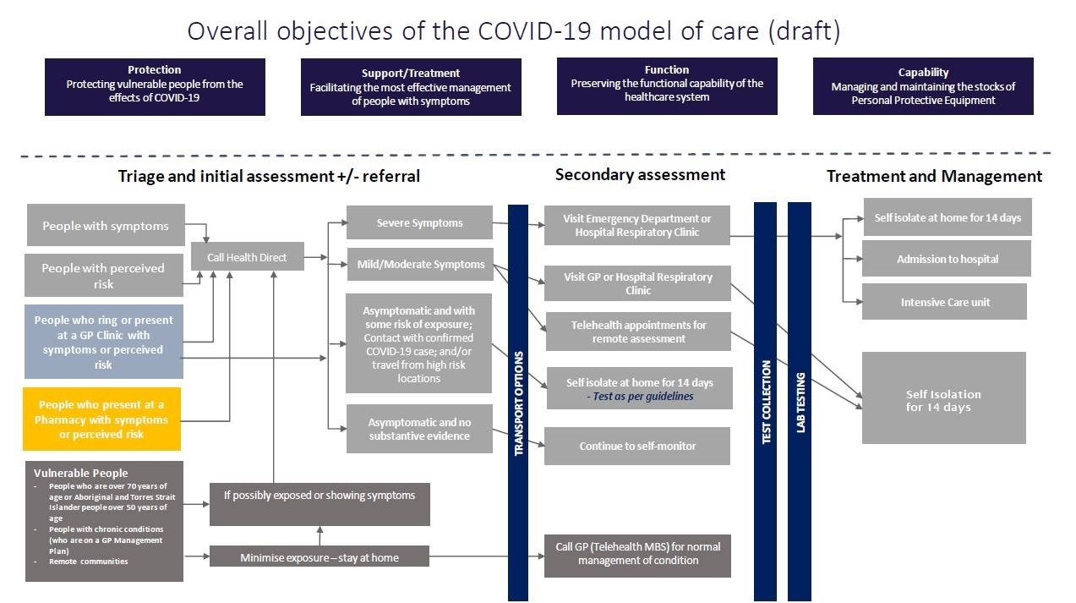
Draft Care Model

Slide 5
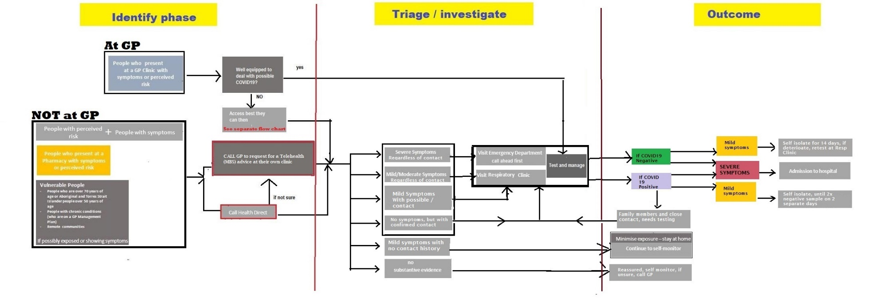
Another Model

Slide 6
FAS Meeting & Practice Practicalities
FAS Meeting
  Reliance on PHN
  Pop up clinic funding
Practicalities of managing a practice in a pandemic.

Slide 7
Business Risks
Things to consider
  Practice Insurance – validity
  OH&S
  Cash flow maintenance and business risks
    25 weeks
    staff availability,
    business continuity
  Telehealth considerations
      Platform standards,
      Platforms,
      MBS item numbers and Bulk Billing

Slide 8
Business Risk
8. Infectious diseases, murder, suicide
✔ What we cover Loss or damage as a result of the closure or evacuation of the whole or part of the
premises by order of a competent government, public or statutory authority as a
result of:
(a) infectious or contagious human disease occurring at the premises;
(b) vermin or pests or defects in the drains or other sanitary arrangements at the premises;
(c) poisoning of customers directly caused by the consumption of food or drink provided
on the premises;
(d) the outbreak of a notifiable human infectious or contagious disease occurring within
twenty (20) kilometres radius of the premises;
(e) murder or suicide occurring at the premises; or
(f) shark or crocodile attack occurring within a 20 kilometre radius of the premises.
✘ What we exclude We will not pay any claim that is directly or indirectly caused by or arises from, or is in
consequence of or contributed by:
(a) cleaning, repairing or checking your premises; or
(b) any Quarantinable Disease (as the term is defined in the Quarantine Act (C’th) 1908 and
any subsequent amendments) or Highly Pathogenic Avian influenza.

Slide 9
Q&A
PPE availability
  workarounds
Telehealth experience
To test or not to test
Practice Practicalities

