Slide 1

Business KPIs for General Practice
Todd Cameron & Jagadish Krishnan

Slide 2
Key Performance Indicators/Objectives
Need to be meaningful
Need to measure service, quality and financial performance
Need to map trends as well as be used to predict performance and adjust

Slide 3
1. Occupation/ Premises
No. of FTE based on square meters (50sqm/FTE)
  Example: Practice size 300 sqm should have 300/50 = 6 FTE
No. of FTE based on completed appointments (30 Appointments/week day)
  Example: 600 completed appointments in one week – 600/150 = 4 FTE

Slide 4
2. Appointments
Booking Percentage/Yield =Booked Appointments/Completed Appointments
Cost of Booking per Appointment = Admin Wage/Booked Appointments
Unmet demand as a predictor

Slide 5
3. Earnings
Per Patient Average – Total Billings/Completed Appointments = Per Patient Average (Clinic and GP)
Patients per hour
Hourly Earnings – Total Earnings/No of hours worked = Hourly Earnings

Slide 6
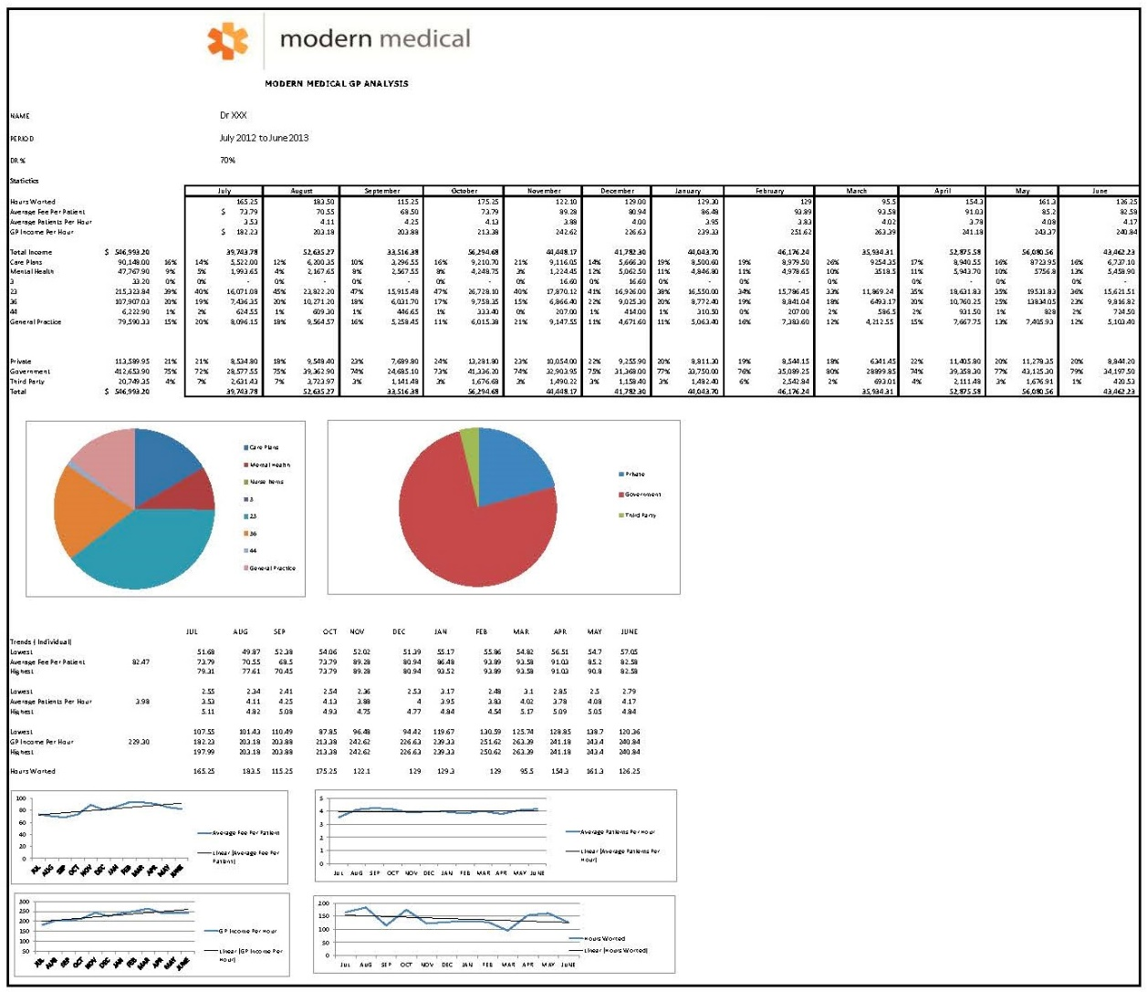
Earnings

Slide 7
4. Admin Staff
Admin Staff Ratio = Doctor Consult Hours/Admin Staff Hours
Wage to Turnover Ratio = Total Billings/ Wage Cost (Including on-costs)
Bookings Per Hour = No of bookings by a particular staff/No of hours by a particular staff

Slide 8
5. Nursing Staff
Nurse Appointments (Available/Booked/Completed)
Nurse Earnings – Billings of patients from Nurse Appointments
Nurse Earnings Per Patient Average = Billings of patients from Nurse Appointments/Completed Appointments by Nurses

Slide 9
Quality
Use RACGP / Accreditation indicators
Quality and financial performance need to be mapped to determine inflexion points
Make this context specific

Slide 10
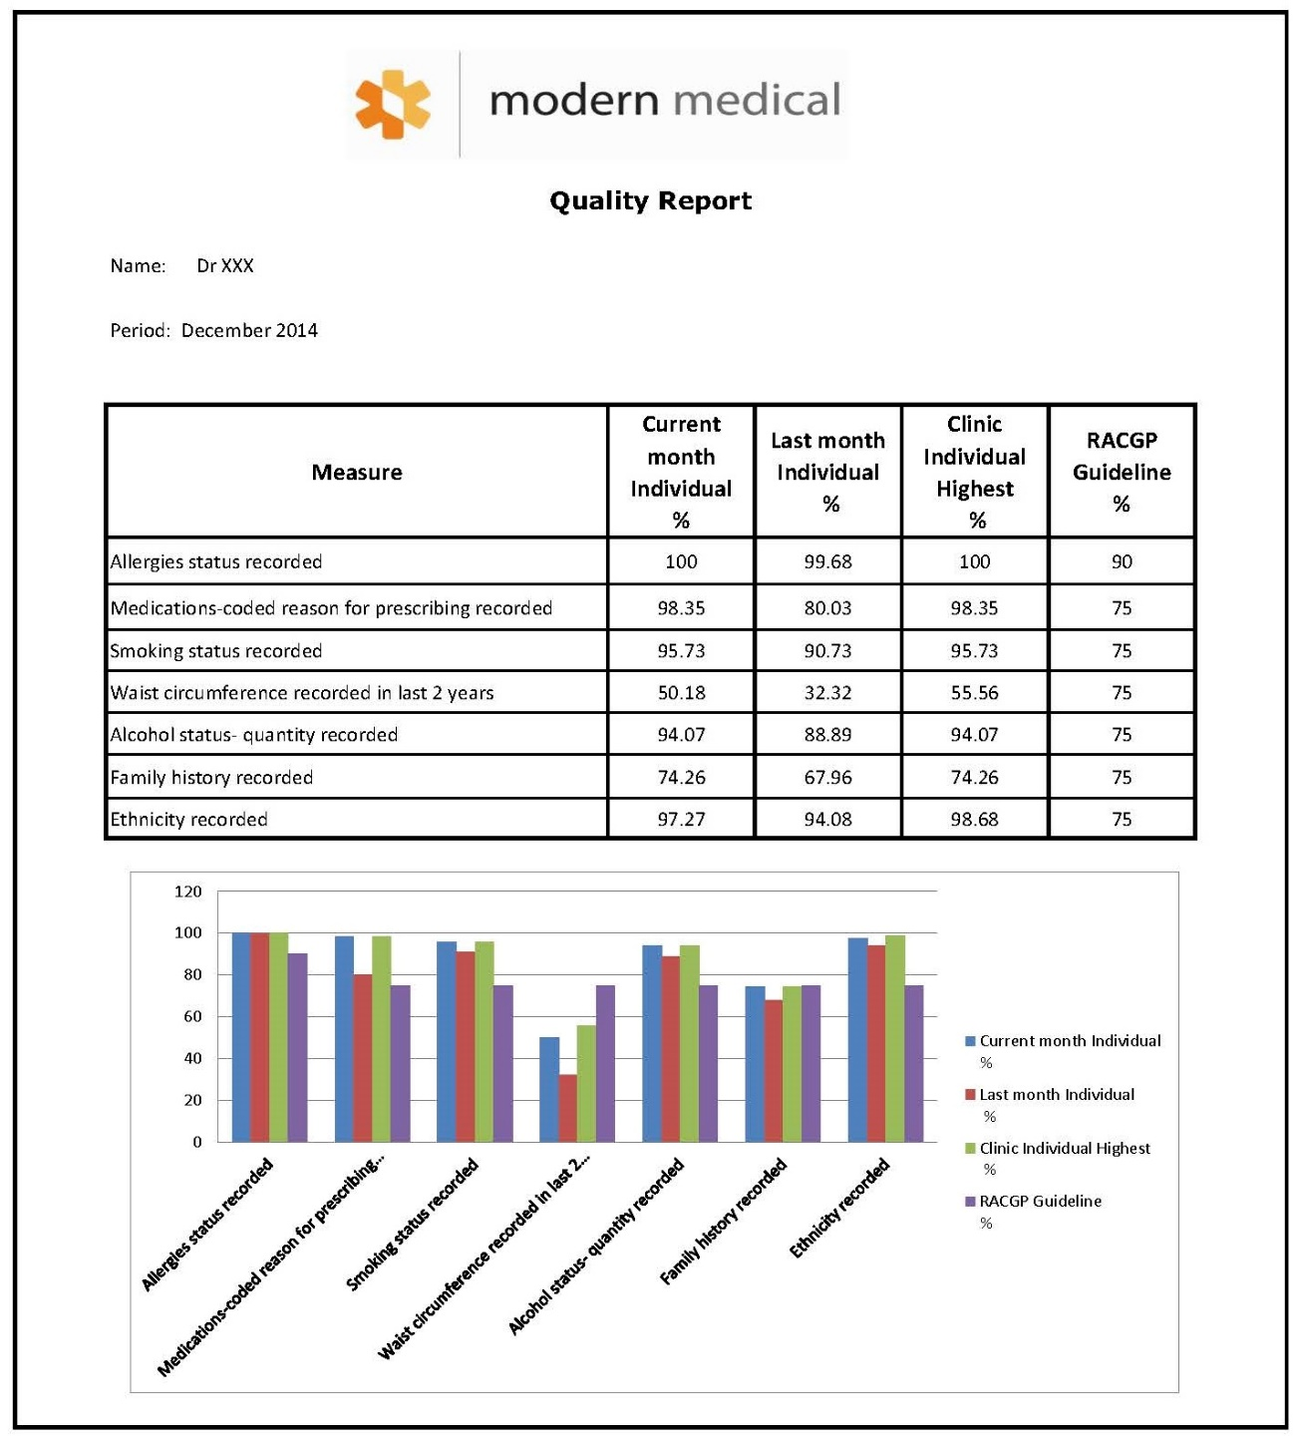
Quality

Slide 11
Service Standard
Make this context specific
For example telephone call volume and wait times/ drop outs as a KPI for reception
Days wait between scanned documents being allocated and a target for such
DNA or failure to pay and so forth

